Slide 1
SDSU Campus Network
Mitchell Wilber &
Adam Stammer

Slide 2
Behaviour and Information Technology (2002)
Surveyed students and professors at 166 universities
Computer Experience
Perceived Value
Ease of Use

Slide 3
International Journal of Mental Health and Addiction (2017)
96% of University Students polled use the internet
Positive impact outweighs the negative

Slide 4
THE PROBLEM

Slide 5
Methods of Measurements
ZTE Axon Pro (Android 6.0.1)
“Wifi Analyzer” by farproc
Signal Strength (dBm)
“Speedtest by Ookla” by Ookla
Download/Upload Speeds (Mbit)
Latency (ms)
Jitter (ms)

Slide 6
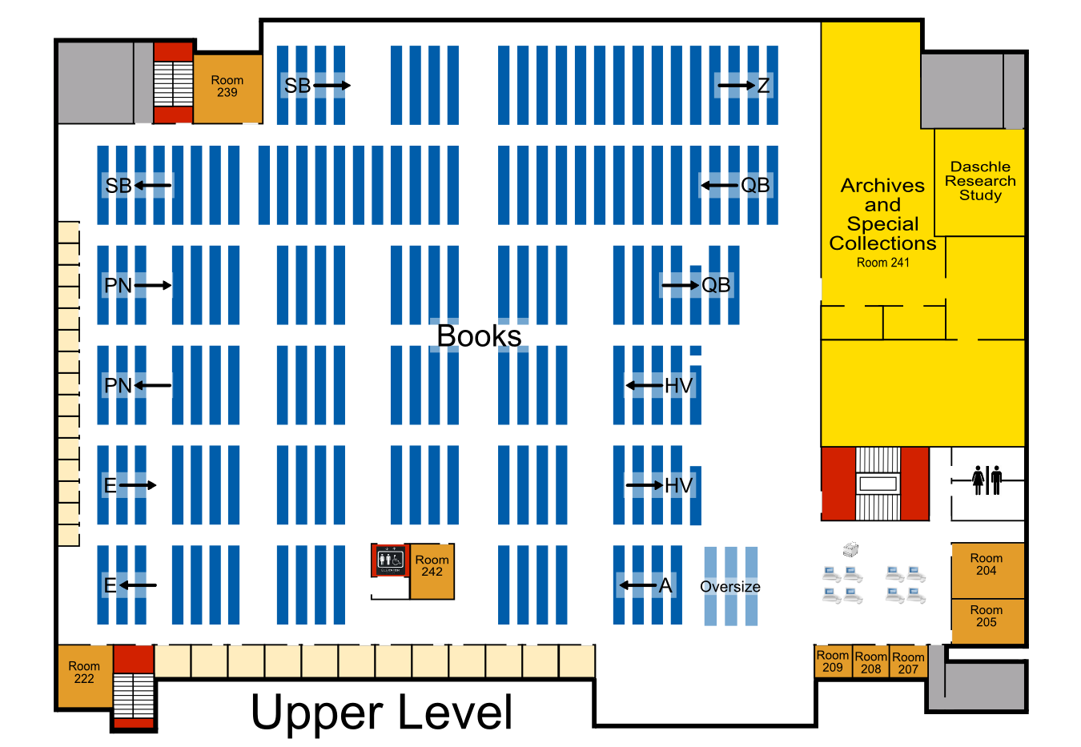

Slide 7
Briggs Library
Location | Best Strength (dBm) | Download (Mbits/sec) | Upload (Mbits/sec) | Ping (ms) | Jitter(ms) | Rating
South Study Rooms | -75 | 1.06 | 0.11 | 3 | 4 | Not Acceptable
South Study Rooms | -80 | No Connection | No Connection | No Connection | No Connection | Not Acceptable
South Center Desks | -58 | 6.66 | 15.7 | 2 | 10 | Acceptable
South West Desks | -72 | 7.8 | 20.8 | 1 | 43 | Acceptable
West Study Rooms | -76 | 1.54 | 0.32 | 52 | 79 | Not Acceptable
North Desks | -68 | 0.75 | 0.45 | 3 | 1313 | Not Acceptable

Slide 8
SDSU Wellness Center
Location | Best Strength (dBm) | Download (Mbits) | Upload (Mbits) | Ping (ms) | Jitter(ms) | Rating
South Side Machines | -83 | 0.3 | 0.07 | 5 | 1078 | Not Acceptable
Northwest Corner | -76 | .48 | .11 | 12 | 28 | Not Acceptable
Northeast Corner | <-90 | No Connection | No Connection | No Connection | No Connection | Not Acceptable
Southeast Corner | -46 | 34.5 | 40.2 | 2 | 0 | Acceptable
Center Water Fountain | -79 | No Connection | No Connection | No Connection | No Connection | Not Acceptable
Front Lobby | -77 | No Connection | No Connection | No Connection | No Connection | Not Acceptable

Slide 9
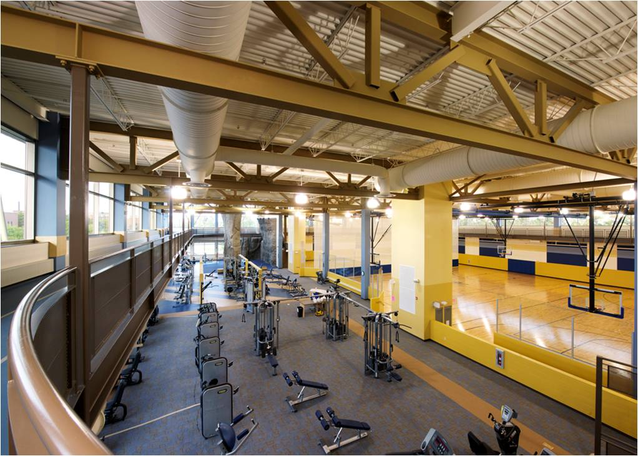

Slide 10
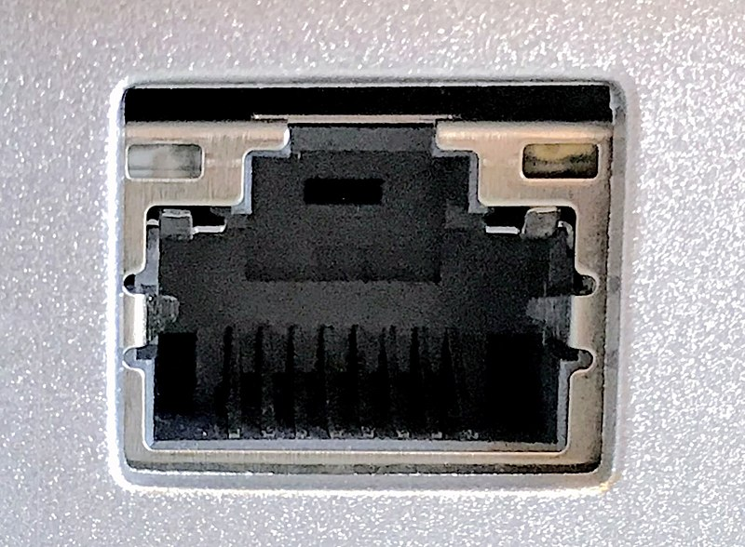
Ethernet
Briggs
Student Union
Brown Hall

Slide 11
THE SOLUTION

Slide 12
Increase Coverage
Add more routers throughout areas of limited coverage
Emphasize areas of (potential) common internet use
Activate ethernet ports in common areas
Day rooms
Student Union
Briggs walk-in study rooms

Slide 13
Measure Success
View statistics of network use
Look for increase/decrease in use
Changes in type of use
Retest coverage
Look for increase/decrease in coverage and speeds

Slide 14
References
Afzaal H. Seyal, Mohd. Noah Abd. Rahman & Md. Mahbubur Rahim. (2010) Determinants of
Academic Use of the Internet: A Structural Equation Model, Behaviour &
Information Technology, 21:1, 71-86, DOI: 10.1080/01449290210123354
South Dakota Board of Regents. Policy Manual. 2018. South Dakota.
Steve Jones. (2003). Let the Games Begin: Gaming Technology and Entertainment Among
College Students. Pew Internet & American Life Project .
Rayan, A., Dadoul, A.M., Jabareen, H. et al. Int J Ment Health Addiction (2017) 15: 118.
https://doi.org/10.1007/s11469-016-9658-2

Slide 15
QUESTIONS?

